Slide 1
Manipulating Pictures, Arrays, and Loops part 4
Barb Ericson
Georgia Institute of Technology
August 2005

Slide 2
Learning Goals
Understand at a conceptual and practical level
  How to trace code
  How to create a new method by copying another one and changing the method name
    And other parts of the method
  How to increase the red in a picture
  How to remove a color from a picture

Slide 3

Tracing Code
An important skill to develop is the ability to trace code
  Also called walking through or stepping through your code
  Look at each line and predict what will happen
  Show the variables and their values

Slide 4
Step Through decreaseRed()
A picture object was created from the file “caterpillar.jpg” and then was sent the message decreaseRed()
The picture object was implicitly passed to the method decreaseRed() and can be referred to by this
The array of pixel objects was returned from sending getPixels() to the picture object
Pixel[] pixelArray = this.getPixels();
Some variables were declared for later use in the loop
    Pixel pixelObj = null;
int index = 0;
int value = 0;

Slide 5
Step Through decreaseRed() - cont
The while loop tests if the index is less than the length of the array
while (index < pixelArray.length) {
  And if so it executes the statements in the body of the loop {}
    It sets the variable pixelObj to the pixel at the current index in the array of pixels
      pixelObj = pixelArray[index];
    It gets the red value of that pixel
      value = pixelObj.getRed();
    it sets the value to the integer part of (red value * 0.5)
      value = (int) (value * 0.5);
    It sets the pixel’s red to the new value
      pixelObj.setRed(value);
    It increments the index value
      index++;
Notes:
After each execution of the loop the test will be executed again. If the test is false execution will jump to the first statement after the body of the loop. If the test is true the statements in the loop will be executed again.

Slide 6
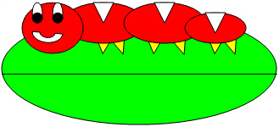
Memory Map of decreaseRed()
width=329
height=150
What does memory look like the first time through the loop?
How about the 2nd time through?
How about the 3rd time through?
How about the last time through?
Picture: Class
getPixels()
…
this
pixels
R=252,
G=254,
B=251,
X=0,
Y=0
R=253,
G=255,
B=254,
X=1,
Y=0
R=254,
G=254,
B=254,
X=2,
Y=0
…
pixel
Pixel: Class
getRed()
setRed()…
value = 252
index = 0
Notes:
The this refers to the object the method was invoked on. This is a picture object so it has a reference to the object that defines the Picture class. The pixels variable refers to the array of Pixel objects. The pixel variable refers to the first Pixel in the array of Pixel objects. Each Pixel object has a reference to the object that defines the class Pixel. The value variable holds the red value for the current pixel. The index starts at 0 and changes each time through the loop.

Slide 7
Increase Red
What if you want to increase red by 30%
  How would you do that?
Multiplying by 0.5 reduces the red by 50%
  Multiplying by 1.0 would keep the same red value
  Multiplying by 1.3 would increase the red by 30%
  Multiplying by 1.7 would increase the red by 70%

Slide 8
Increase Red Algorithm
To increase the red value in a picture by 30%
  Get the array of pixels from the picture
  Set up an index to start at 0
  Loop while the index is less than the length of the array
    Get the pixel at the current index from the array of pixels
    Get the red value at the pixel
    Multiply the red value by 1.3
    Set the red value at the pixel to the reduced red value
    Increment the index and go back to step 3

Slide 9
Increase Red: Algorithm to Code
The algorithm for this method is very similar to the algorithm for decrease red
  Start with the code for decreaseRed
  Change the line of code that multiplied the current red value by 0.5 to 1.3
  Change the name of the method
  Change any comments that need changing

Slide 10
increaseRed Method
/**
* Method to increase the red by 30%
*/
public void increaseRed()
{
Pixel[] pixelArray = this.getPixels();
Pixel pixelObj = null;
int value = 0;
int index = 0;
// loop through all the pixels
while (index < pixelArray.length)
{
// get the current pixel
pixelObj = pixelArray[index];
// get the value
value = pixelObj.getRed();
// increase value value = (int) (value * 1.3);
// set the red value pixelObj.setRed(value);
// increment the index
index++;
}
}

Slide 11
Testing increaseRed
Underwater pictures look too blue
  The water filters out most of the red color
To test increase red:
  String file =
  “c:/intro-prog-java/mediasources/water.jpg”;
  Picture p = new Picture(file);
  p.explore();
  p.increaseRed();
  p.explore();
Notes:
You may want to increase red several times to correct the too blue water picture. Use the explorer to check the red values in the original picture and the one with the red increased.

Slide 12
Clear the Blue Values
What if you want to clear the blue from a picture?
  Set all the blue values to 0 for all the pixels
The algorithm is similar to decreaseRed() and increaseRed() except
  You don’t need to get the value out for blue and multiply it by some value and then set the blue value
  Just set the blue value to 0

Slide 13
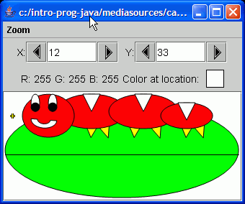
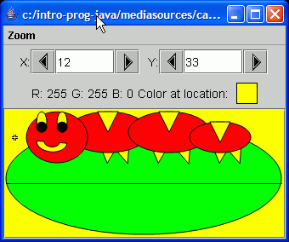
Clear Blue Exercise
In Picture.java
Write the method
  public void clearBlue()
That sets the blue value to 0 for all pixels in a picture
Test with:
String fileName =
“c:/intro-prog-java/mediasources/caterpillar.jpg”;
Picture p = new Picture(fileName);
p.explore();
p.clearBlue();
p.explore();
Notes:
When you clear the blue the white in the picture will look yellow.

Slide 14
Summary
Tracing code is walking through code and saying what each line is doing
  It can also help to show the values of the variables after each line executes
You can increase the red in a picture by multiplying the red value by a number > 1.0
You can clear a color from a picture by setting the value to 0

